Slide 1
70-533 : Implementing Microsoft Azure Infrastructure Solutions

Slide 2
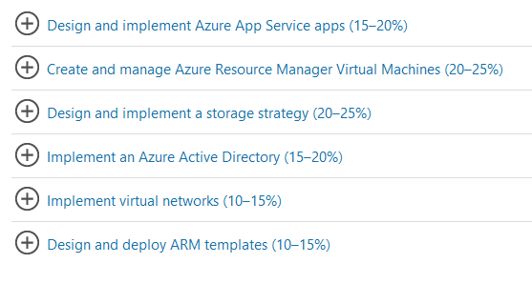
70-533 : Implementing Microsoft Azure Infrastructure Solutions

Slide 3
Implement Images and Disks (VM storage)

Slide 4
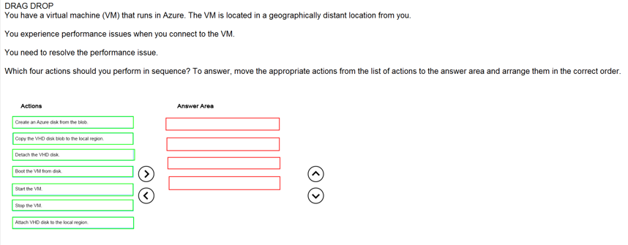
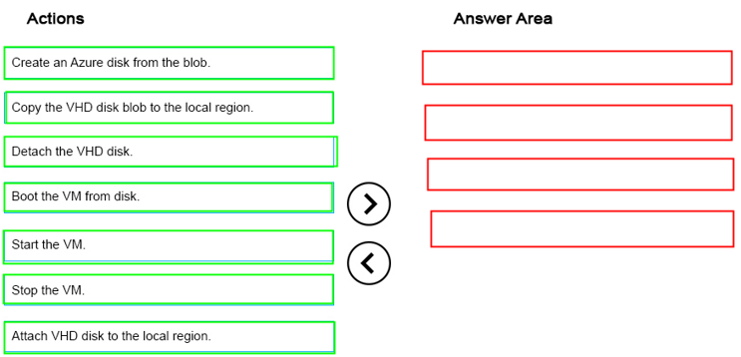
Ans =
Latency Low in local region

Slide 5
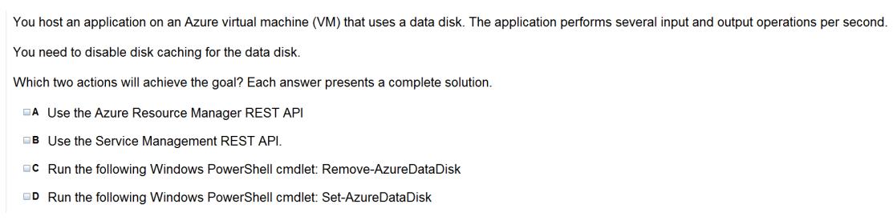

Slide 6
Operating system disk- Every virtual machine has one attached operating system disk. It’s registered as a SATA drive and is labeled /dev/sda by default. This disk has a maximum capacity of 1023 gigabytes (GB).
Temporary disk- Each VM contains a temporary disk. The temporary disk provides short-term storage for applications and processes and is intended to only store data such as page or swap files. Data on the temporary disk may be lost during a maintenance event or when you redeploy a VM. During a standard reboot of the VM, the data on the temporary drive should persist.
Data Disk - A data disk is a VHD that’s attached to a virtual machine to store application data, or other data you need to keep. Data disks are registered as SCSI drives, A data disk is a VHD that’s attached to a virtual machine to store application data, or other data you need to keep. Data disks are registered as SCSI drives and are labeled with a letter that you choose. Each data disk has a maximum capacity of 1023 GB. The size of the virtual machine determines how many data disks you can attach to it and the type of storage you can use to host the disks.

Slide 7
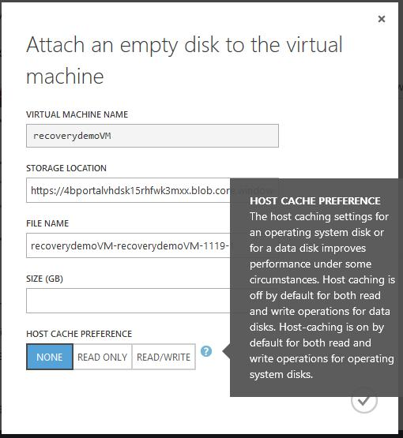

Slide 8
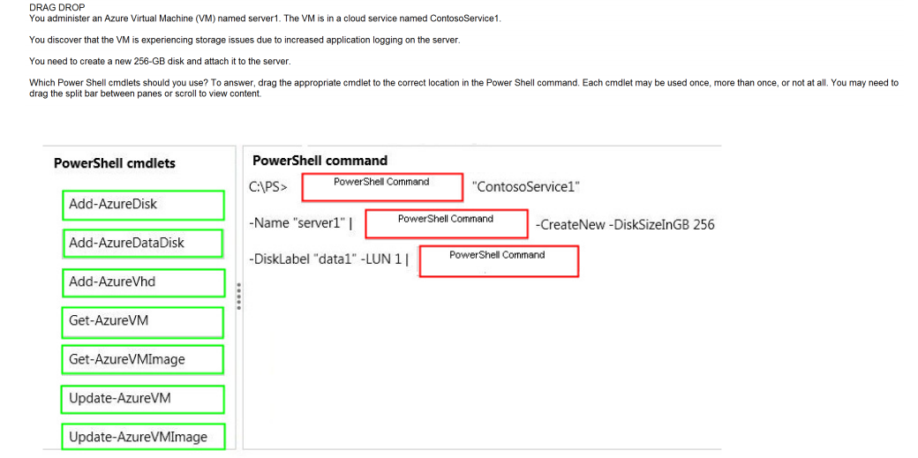
Ans =
The set-Azuredisk is for caching setting

Slide 9
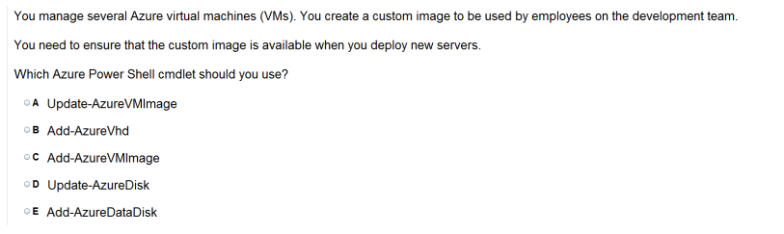

Slide 10
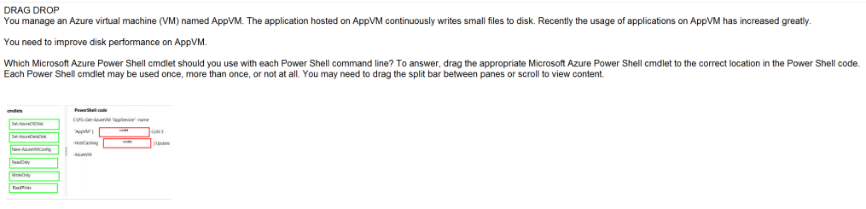
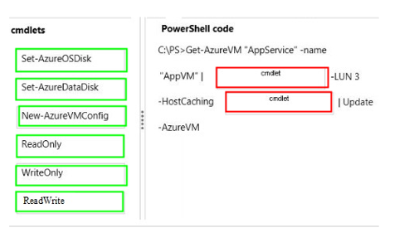
Ans =
The job here is to increase the performance of OS disk to read the data written over data disk ( as you are writing small files )

Slide 11
Perform Configuration Management

Slide 12
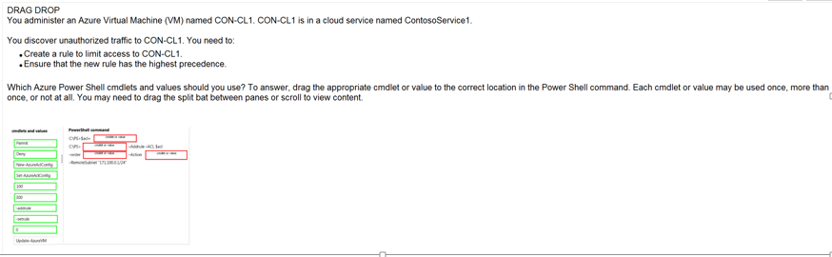
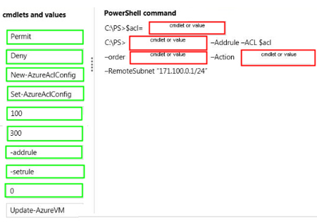
Ans =

Slide 13
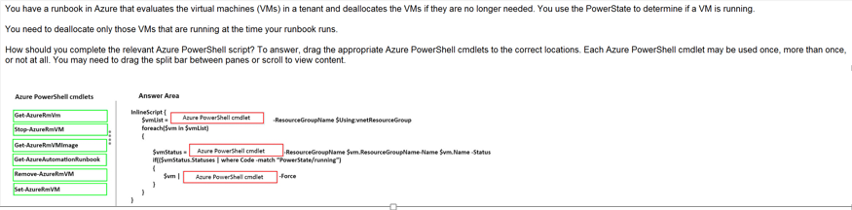
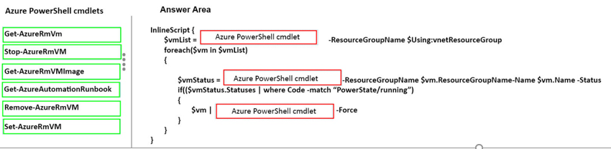
Ans =
Runbook is a set of task for performingsome automated process

Slide 14
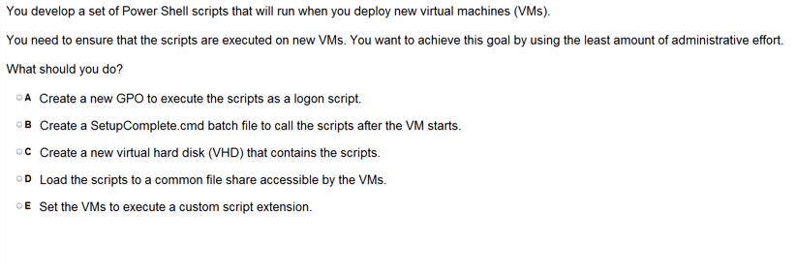

Slide 15
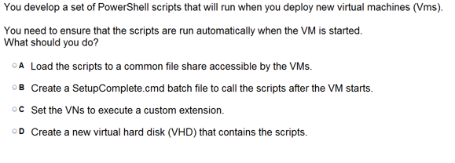

Slide 16
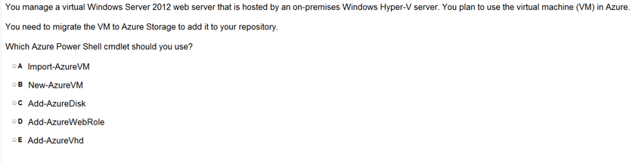

Slide 17
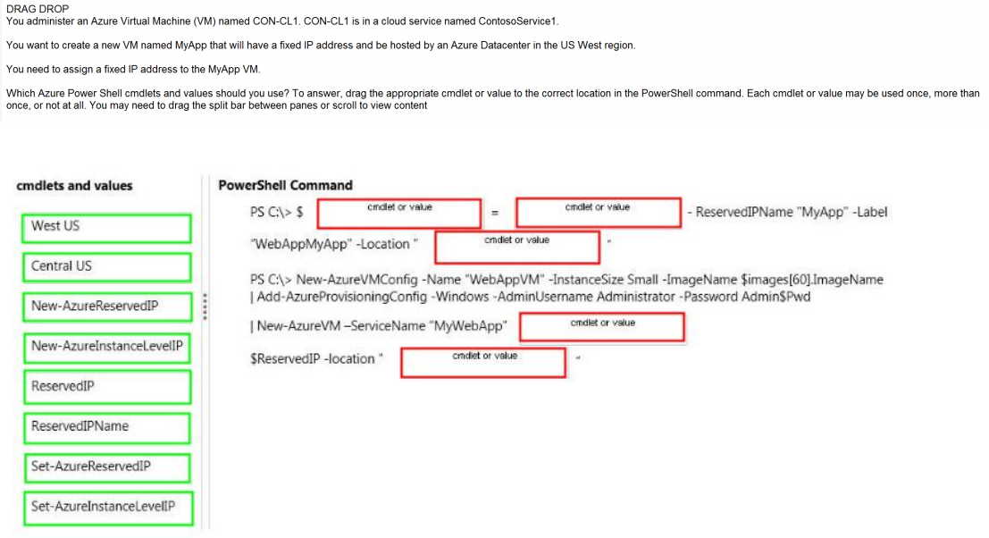
Ans =

Slide 18
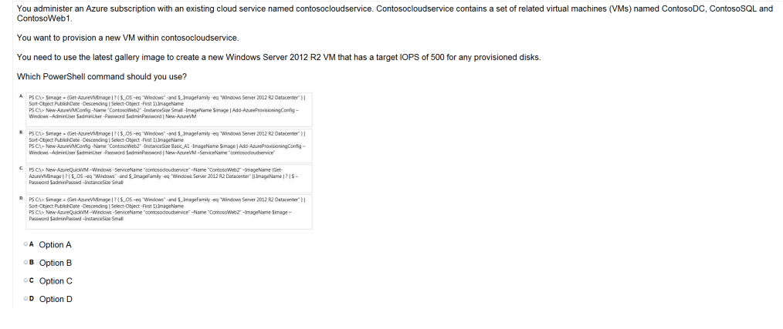
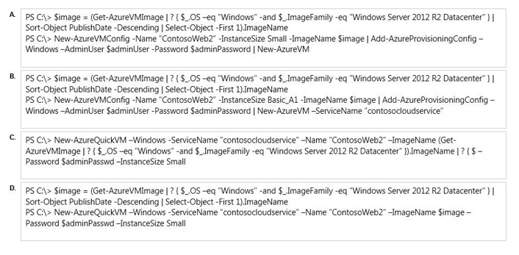

Slide 19
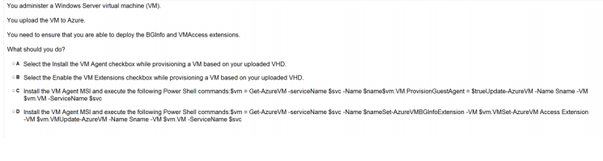

Slide 20
Deploy VM and Workload

Slide 21
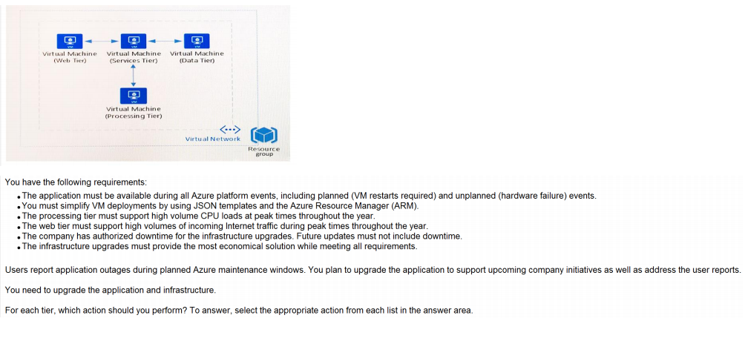
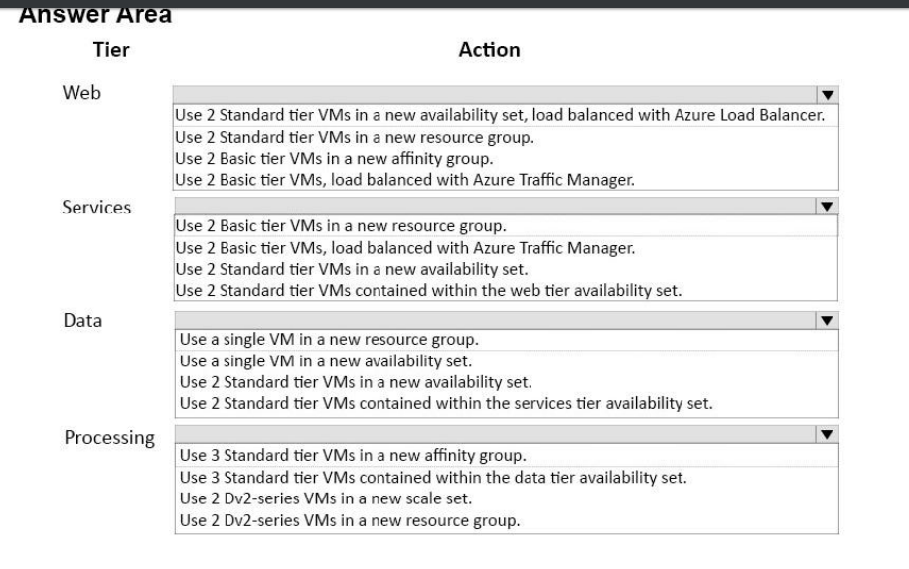

Slide 23
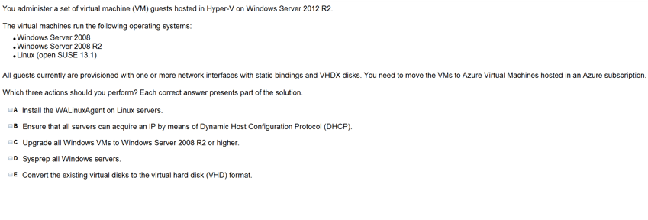

Slide 24
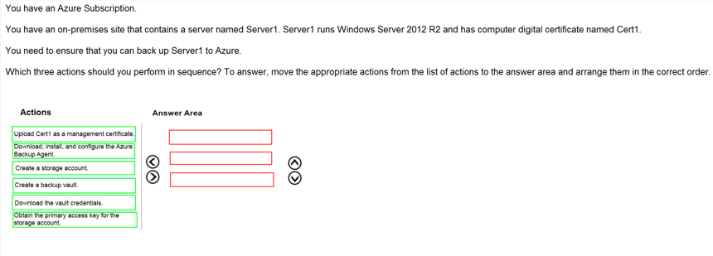
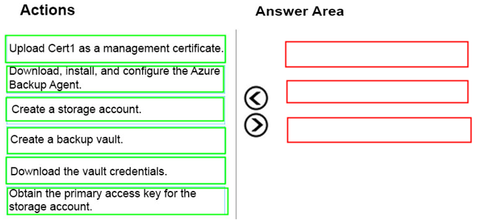
Ans =

Slide 25
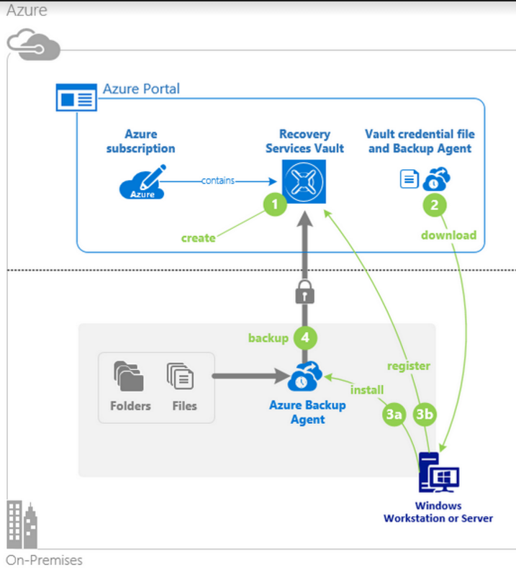

Slide 26
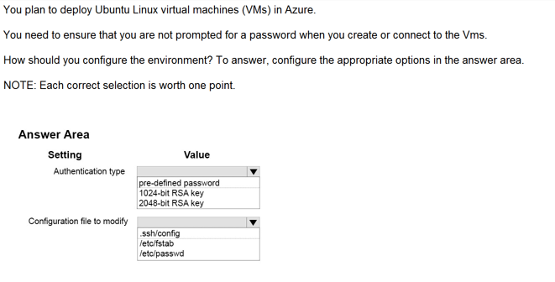
Ans =
The Authentication Type is not selected for User name and password.

Slide 27
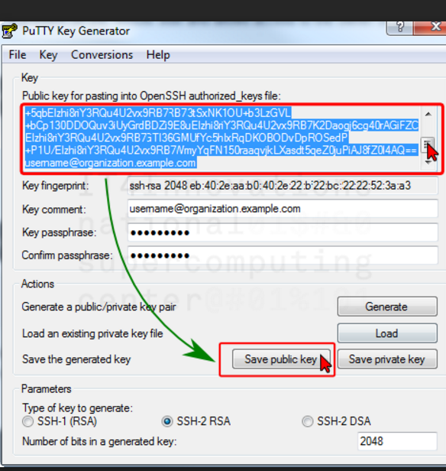

Slide 28
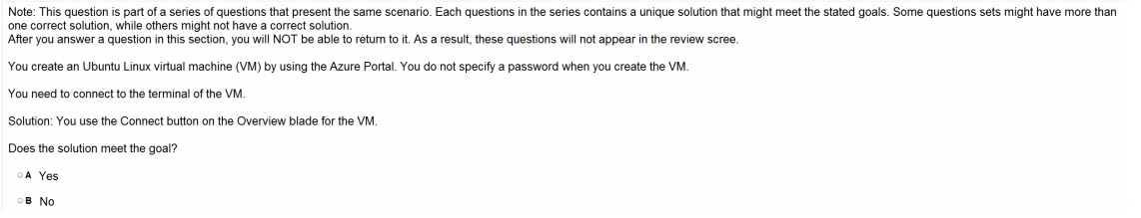

Slide 29
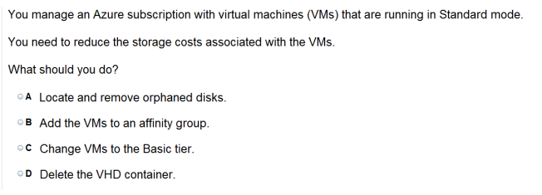

Slide 30
